Slide 1




SMI UNIVERSITY
DATABASE SYSTEMS PROJECT
A Comprehensive Study of Real-World Scenarios
ASSIGNED BY
Akbar Ali
Wasif Ahmed Siddiqui
SIR ASIF ARSHAD
BDA-25S-028
BDA-25S-029
Course Instructor

Slide 2



OUR MOTIVATION
Theory vs. Practice
Clarity of Concepts
We wanted to go beyond textbooks. This project helped us understand how database concepts are applied in actual software like SQL Server 2012.
Advanced concepts like entities, relationships, views, and indexes become much clearer when you implement them yourself in a proper system.

Slide 3






PROJECT OVERVIEW
University System
Hospital System
E-Commerce System
Managing students, courses, and complex enrollment cycles.
Handling patient medical records, doctors, and billing.
Processing retail orders, inventory, and deliveries.
"Three scenarios, one unified database architecture designed for real-world utility."

Slide 4

SIGNIFICANCE
Databases are everywhere. From government apps like NADRA to e-commerce giants like Daraz, data management is the core of modern tech.
Learning how to design these systems improves technical knowledge, logical reasoning, and prepares us for professional careers in Data Science.

Slide 5

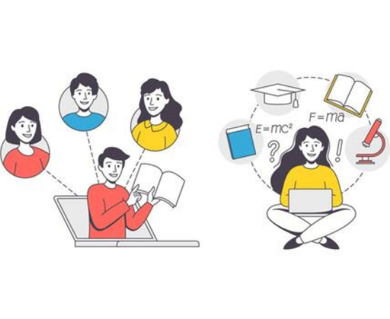
UNIVERSITY MANAGEMENT
Student Profiles: Tracking programs, departments, and exams.
Course Cycles: Managing sections, instructors, and enrollments.
Derived Data: Automated calculations for exam scores and results.

Slide 6
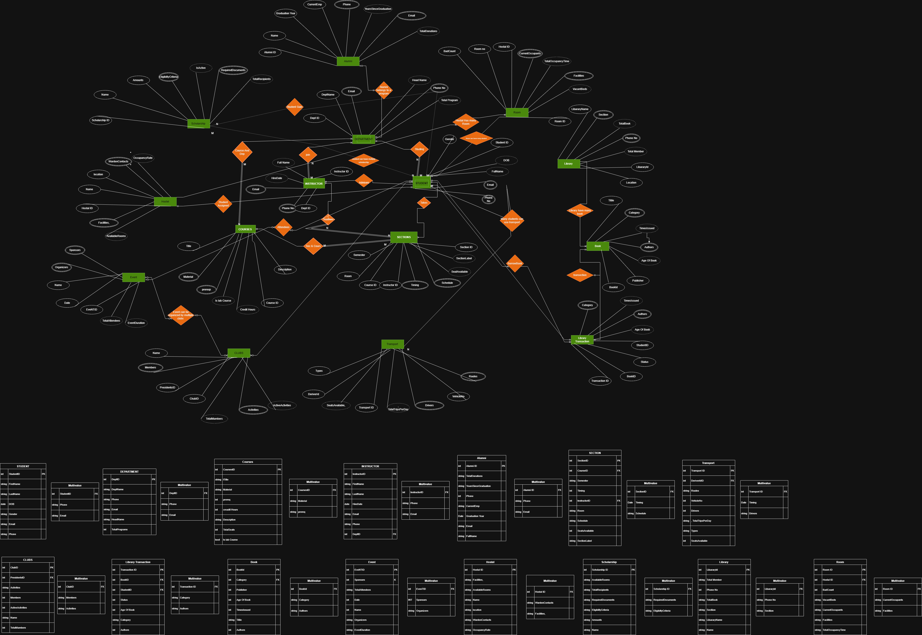
University(ERD)

Slide 7


HOSPITAL SERVICE SYSTEM
Patient Care & Administration
Our system efficiently handles the complex workflows of a modern hospital:
Appointments and admissions tracking.
Doctor assignments and medical prescriptions.
Integrated billing and payment methods.

Slide 8
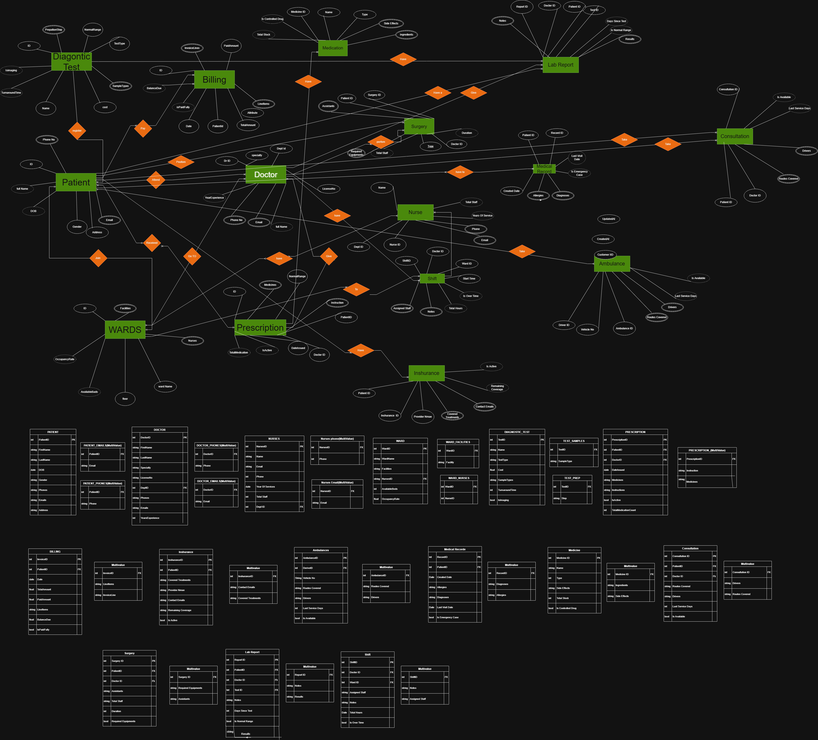
HOSPITAL(ERD)

Slide 9
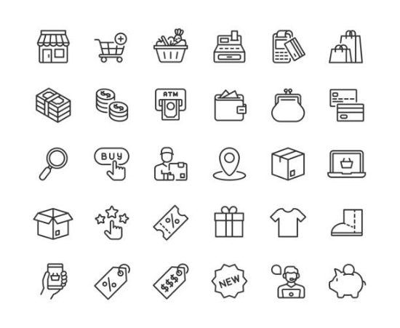
E-Commerce System
Designed to mirror platforms like OLX or Daraz, this module focuses on transactional data integrity:
Catalog: Vendors, categories, and products.
Logistics: Orders, carts, and delivery tracking.
User Experience: Wishlists and return management.

Slide 10
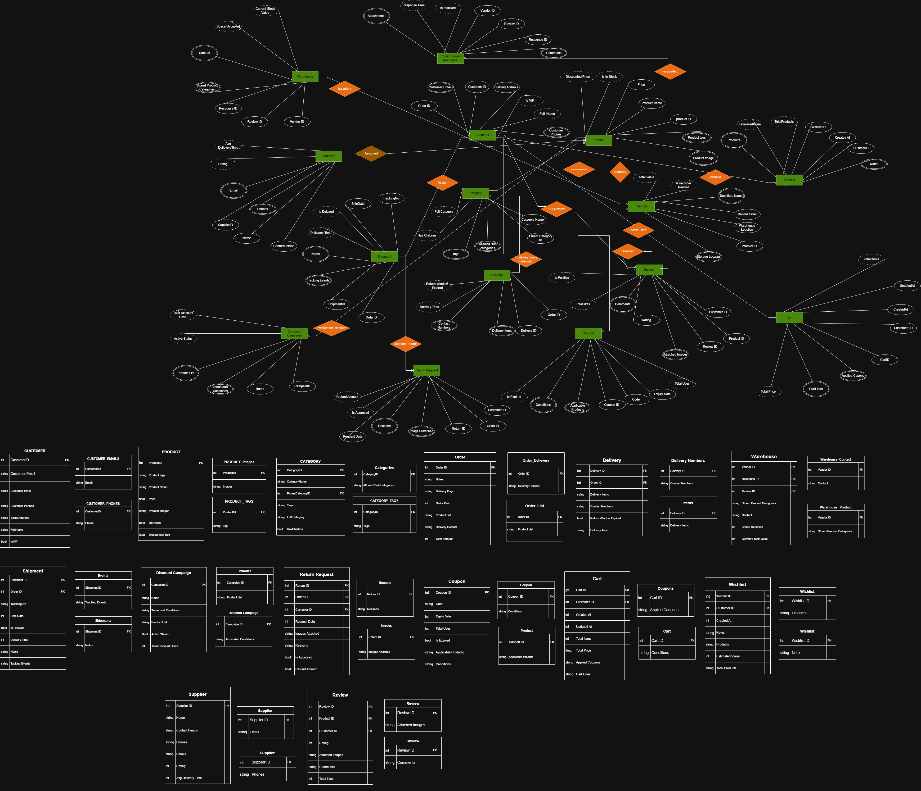
E-commerce(ERD)

Slide 11
SALIENT FEATURES
Massive Datasets: Handled over 20,000+ records smoothly.
Performance: Implementation of Views and Indexes.
Clean Logic: Scenario-specific naming (e.g., DepartmentsH) to avoid conflict.
Integrity: Rigorous use of Primary and Foreign Keys.
Derived Attributes: Calculated data stored for each scenario.
Integrity: Robust Update queries and Data Validation.

Slide 12
TECHNICAL REQUIREMENTS
Category | Specification | Purpose
Hardware | Laptops and High-speed internet. | For research
RDBMS | Microsoft SQL Server 2012 | Core database engine
Interface | SQL Server Mgmt Studio (SSMS) | Administering database instances
Scripting | Python | Generating 20,000+ dummy records

Slide 13
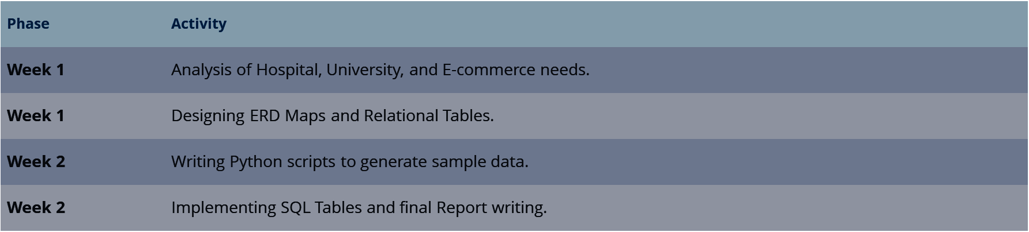
PROJECT TIMELINE

Slide 14




REFERENCES & SOURCES
Draw io
Technical
Python
online tool used to draw the EDR maps and logic diagram
Microsoft SQL Server 2012 Documentation
Python Used to generate realistic simple data for testing the system.

Slide 15
THANK YOU
QUESTIONS?
Akbar Ali | Wasif Ahmed Siddiqui SMI University - Department of Software Engineering

